Slide 1
Loan Prediction for Risk Assessment
ARJUN ACHUTHAN
SHREYAS SHIVA KUMAR

Slide 2
Problem
Loan default is one of the major issue faced by lending firms.
High time taken to process loan requests by lending agencies due to the risks involved.
Lack of means to detect potential defaulters.

Slide 3
Project Goal
Develop a prediction model that can be used by managers to successfully predict whether the applicant is likely to pay back the loan or not.
If this predictive model can be translated into the real world’s loan data successfully, the risks involved in the process of loan disbursement can be significantly reduced and the processing of loans can be faster.

Slide 4
Project Objectives
Objective 1: Identify the key factors that most significantly explain the variability in loan repayment status of the applicants.
Objective 2: Analyze to what extent each of these factors contribute towards the variability in loan repayment status of the applicants.
Objective 3: Develop the predictive analytics model using SAS Enterprise miner and try to leverage advanced feature of SAS Enterprise miner platform to efficiently predict the Loan status with best accuracy. Also to gain a deeper understanding about SAS EM platform in the process.

Slide 5
Benefitters
The direct benefitters of this project are the bank or lender and the applicant. The bank saves a lot of time and revenue by eliminating the higher risks applicant.
This model can be extended to determine which account holders in the bank are eligible for the loan and up to what amount. Thus, market basket analysis as well as prediction analysis both are chief applications of the proposed model.

Slide 6
Data Overview
Our data consists of 17 variables, Loan Status being our target variable.
Before data cleaning, it contained data about 100,000 applicants with relevant financial background information to issue the loan.
After cleaning, we have about 90,000 instances left to process in our modelling techniques.
We decided to split our data in the ratio of 70-30.

Slide 7
Data Description
The data is raw and unprocessed.
It was diverse with both, categorical and continuous variables.
There are many inconsistencies, missing values, unknown values etc. most of which, are likely due to human error.
To proceed further the data had to be processed and because of the anomalies that existed, significant amount of time was spent to make the data more consistent.
Some of the variables had to undergo transformations(Ex: Log) to get more accurate results for our prediction.

Slide 8
Data Cleaning
Looking at the data on a general sense understand that variables like Credit score, Annual income, Bankruptcies are extremely important variables.
If there variables contain many errors the results tend to be less accurate.
We identified the following Anomalies.
Credit Score – Values where not in the range of 300 to 850.
Variables with Missing values - Annual Income, Last Delinquent, Bankruptcies, Tax Liens
Inconsistent variables - Home Ownership, Job Experience.
Variables that required Transformation - Annual Income, Current Credit Balance, Current Loan Amount.

Slide 9
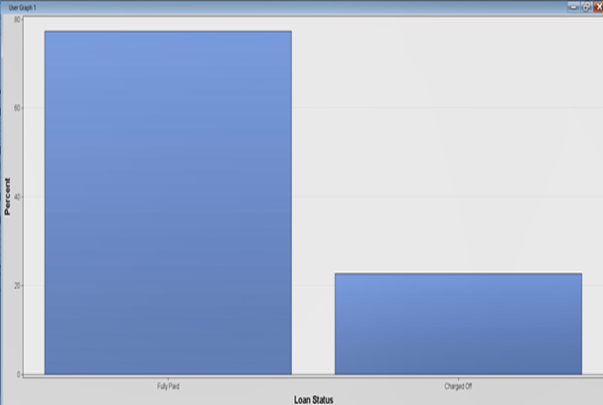
Loan Status
The Loan status which is the Target variable.
It has two categories, fully paid and charged off.
It can be observed that significantly a large number of customers repay loans on time.
But more importantly we see close to one-fourth of the customers have their loans charged off. This may seem like a smaller amount compared to the other variable but in a financial organization this is considered a huge lose as the gross profit of the company is severely affected by this.

Slide 10
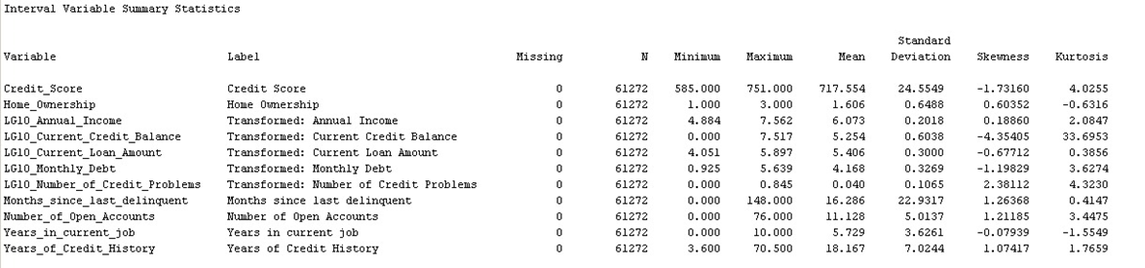
Descriptive Statistics
The image below shows the descriptive statistics of all the variables once they are cleaned and Transformed.

Slide 11
Modeling Techniques
Modeling is an important step to analyze the patterns in our data and extract the insights.
Based on the exploratory analysis performed on our data, the following 3 machine learning algorithms are used to build our models.
Decision Tree
Logistic Regression
Neural Network
Notes:
●Since the target variable is a categorical variable, we built decision tree and logistic regression models for better classification.
●Since we transformed our data to get close to normality, these models are expected to perform well on classification.

Slide 12
Decision Tree
Decision Tree is one of the most preferred algorithm used for classification.
As the name suggests decision tree builds the model in a tree structure.
It can be interpreted very easily.
Minimal data preprocessing is required for decision tree.
Decision Tree can handle both categorical and numerical data.

Slide 13
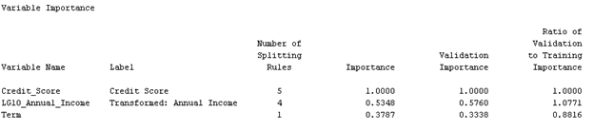
Decision Tree - Results
One main advantage of the decision tree model is that it provides the variable importance importance.
We could easily obtain the most important factors (variables) from both the decision tree structure as well as from the variable importance output.
Credit score is the most important variable (we can observe first split here) followed by annual income and term of the loan.
Notes:
Decision tree implicitly calculates the variable importance and provides the same in the output.
The topmost node in the tree structure can be considered as the most important variable for splitting the data.
The complexity of the tree increases when there are more nodes present.
However we look at the misclassification rate before selecting our final model.

Slide 14
Logistic Regression
When the target variable is categorical, the most common technique used is logistic regression.
Logistic regression model handles the non linear effects between the errors than any other model.
Logistic regression model provides the log odds ratio and in turn the probability of the outcomes which is easier to interpret.
The complexity of the model increases when the target variable has more than two levels (Multinomial).
Notes:
Logistic regression model handles the non normal and non linear data efficiently.
It need not follow the assumptions of linear regression model and hence saves time in data preprocessing

Slide 15
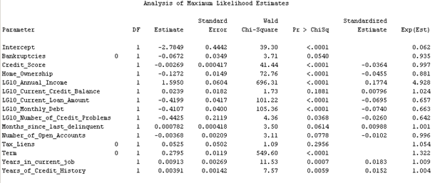
Logistic Regression - Results
We can also obtain the values of each variable that can affect the log odds ratio.
The most important variables are credit score, annual income, home ownership, loan amount, monthly debt and term of the loan.
Notes:
The variables with p-value less than the significance level are considered important.
We can also estimate the change in log odds ratio when there is a change in each variable.
It can be interpreted as a unit change in the credit score changes the log odds value by -0.0364 units.

Slide 16
Neural Network
Neural network is similar to the human nervous system that contains artificial neurons and connections between them.
Neural network algorithm is a powerful technique used that can be used both for classification and regression.
In case of classification, it combines all the possible states of all the input variables with the target variables and train the model.
One disadvantage is that it requires more data for training.

Slide 17
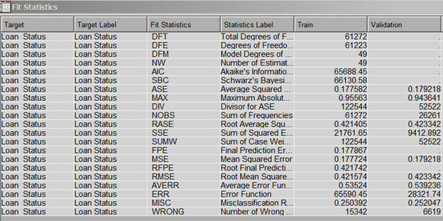
Neural Networks - Results
Since our target variable is a categorical variable, we look at the misclassification rate to check the performance of the model.
The misclassification rate in neural networks model is 25.2%.

Slide 18
Model Assessment
Model Assessment is an important step in the lifecycle of Data Mining.
Performance on the testing/validation data independent from training data is to be considered in model selection.
Since our target variable is a binary categorical variable, we use misclassification rate as the selection criteria.
Misclassification rate is defined as the percentage of wrongly classified observations. It should be lesser for a model to perform better.
We can also look at other metrics such as sensitivity, specificity and accuracy as well in selecting a model.
Notes:
A better model is with less misclassification and error rates that has balance between bias and variance.
Lesser the error rates, better the model.
Sensitivity = True positive rate
Specificity = True negative rate

Slide 19
Model Assessment - Metrics
Sensitivity: Sensitivity is defined as the measure of correctly classifying the true positives in the data.
Specificity: Specificity is the measure of correctly classifying the true negatives in the data.
Accuracy: Accuracy is defined as the overall measure of true positives and true negatives classified in the whole data
Misclassification rate: Misclassification rate is the measure of errors classified in the data. It is also defined as 1-accuracy.
Misclassification should be lesser for a model to perform better than the others.

Slide 20
Model Assessment - Metrics
Sensitivity: Sensitivity is defined as the ability of the model to correctly classify the true positives (success scenarios) in the data.
Specificity: Specificity measures the ability to correctly classify the true negatives in the data.
Accuracy: Accuracy is the overall measure of classifiying the true positives and true negatives in the whole data.
Misclassification rate: Misclassification rate is the rate of errors in the data. It is also defined as 1-accuracy.
Misclassification should be lesser for a model to perform better.

Slide 21
Model Assessment Contd
From above metrics, we can see that the decision tree model correctly identifies 98.14% of the cases when loan status = 1. It can correctly classify 20.6% of the cases when loan status = 0.
Overall, it can correctly classify the loan status in 78.34% of the cases. It wrongly classifies From the above metrics, we could see that the decision tree model correctly classifies 98.14% of the cases when loan status = 1 and can correctly classify 20.6% of the cases when loan status = 0.
Overall, it can classify the correct loan status in 78.34% of the cases. It wrongly classifies the loan status in 21.6% of the cases.
Even though the sensitivity of the other models is high, the misclassification rate is lesser for the decision tree model. Hence, we consider decision tree to be the better model compared to others.
Model/validation Metrics | Misclassification rate | Sensitivity | Specificity | Accuracy
Decision Tree | 21.6% | 98.14% | 20.6% | 78.34%
Logistic Regression | 25.6% | 98.2% | 14.6% | 74.5%
Neural Network | 25.2% | 98.49% | 15.7% | 74.8%
Notes:
The overall accuracy = True positive+True negative/(true positive+true negative+false positive+false negative)

Slide 22
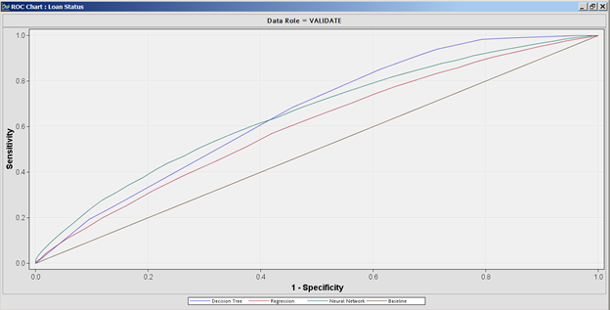
Model Assessment Contd
ROC curve is another method to describe the performance of the model. If the area under the curve is more, better the model. Decision tree model has more area under the curve.
Notes:
ROC curve is plotted against true positive rate and false positive rate. The values ranges between 0 and 1. If the values are closer to 1 then it is considered to be a perfect model. In our case, decision tree has more area under the curve and hence we can say that it is a better model.

Slide 23
Model Assessment Contd.
We consider decision tree is better model for following reasons:
From model assessment results, we can observe that Decision tree fits the data better compared to other models.
From the ROC graph, we can see that decision tree curve has more area under the curve which says model is good at predicting the loan status variable.
Also, it is easier to interpret the results of decision tree.

Slide 24
Conclusion
We can draw following conclusions from the prediction model we have built:
Credit score, Annual Income and Term play an important role in identifying the defaulters.
Lenders can use the above variables and filter out the Applicants who have low Credit score, Annual Income and Term.
An applicant with Credit score above 740, has higher probability of repaying loan.
A loan application for short term, with annual income >1 million and credit score above 725 has better probability of loan repayment, whereas in case of low credit score, the applicant is highly likely to be a defaulter.
Applicants requesting for long term loan, should be thoroughly investigated, as there is high probability for them to become defaulter if they low credit score or annual income.

Slide 25
There is risk of not receiving payment on time from the applicants having large monthly debts.
The applicants with large loan amounts currently, tend to pose risk.
Applicants with home ownership and bankruptcies should be considered cautiously.

Slide 26
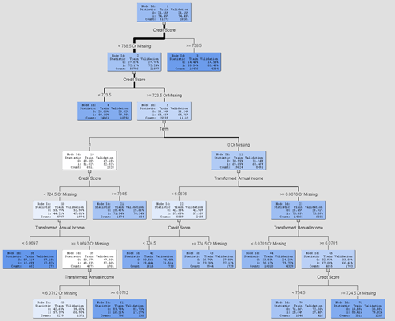
APPENDIX
Decision Tree:

Slide 27
Thank you!

